Slide 1

Customer Shopping Behavior Analysis
Uncovering insights from 3,900 purchases to guide strategic business decisions

Slide 2

Dataset Overview
37
Missing Values
Only in Review Rating column
3,900
18
Total Purchases
Comprehensive transaction data
Data Columns
Customer demographics & behavior

Slide 3
Data Preparation Process
01
02
03
Data Loading
Imported dataset using pandas
Initial Exploration
Structure check and summary statistics
Missing Data Handling
Imputed Review Rating with median values
04
05
Feature Engineering
Created age groups and purchase frequency
Database Integration
Connected to PostgreSQL for analysis

Slide 4
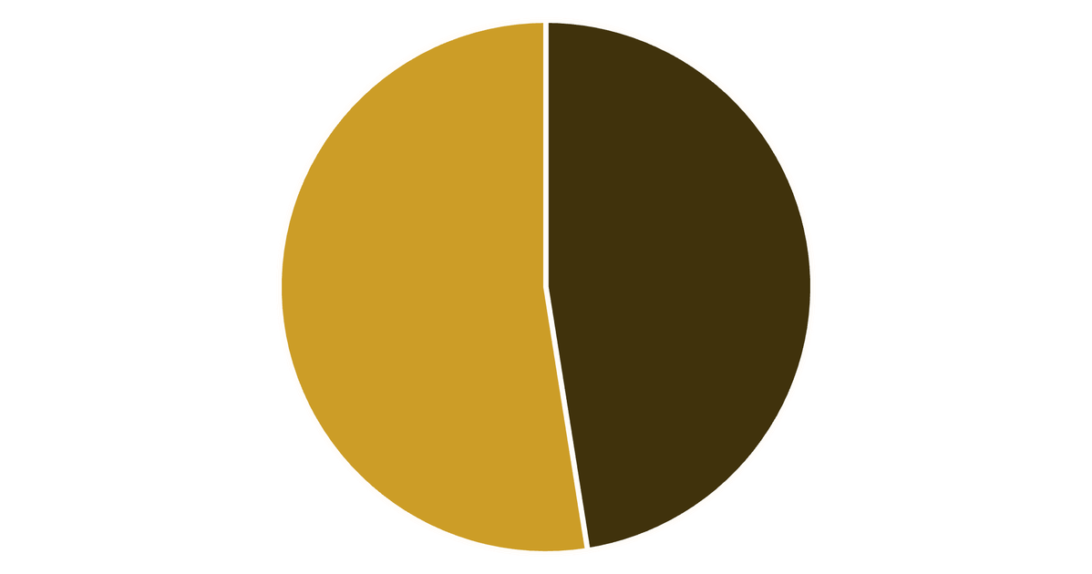

Revenue by Gender Analysis
Key Insight
Female customers generate slightly higher total revenue than male customers
Gender-based marketing strategies could optimize revenue streams
Male
Female

Slide 5

High-Value Discount Users
Customers using discounts while spending above average
Smart Shoppers
High spenders who maximize value with discounts
Strategic Opportunity
Target premium customers with exclusive offers

Slide 6



Top-Rated Products
5
5
4
Blouse
Highest customer satisfaction
Dress
Consistently excellent reviews
Shirt
Strong customer approval

Slide 7

Shipping Preferences Impact
Express Shipping
$65
Standard Shipping
$58
Average purchase amount
Average purchase amount
Express shipping customers spend 12% more per transaction

Slide 8



Subscription Impact
68%
45%
78%
Higher Spend
Subscribers vs non-subscribers
Revenue Share
From subscription customers
Loyalty Rate
Repeat purchase frequency

Slide 9



Customer Segmentation
Loyal
15% - High value customers
1
Returning
35% - Regular shoppers
2
New
50% - First-time buyers
3
Focus on converting New to Returning, Returning to Loyal

Slide 10





Strategic Recommendations
Boost Subscriptions
Promote exclusive benefits for subscribers
Loyalty Programs
Reward repeat buyers to increase retention
Targeted Marketing
Focus on high-revenue segments and express users
Product Positioning
Highlight top-rated products in campaigns

